Slide 1
27 January 2026
Evaluating Temporal Dimensionality Reduction Methods for ERP-Structured EEG Data
Visualization Institute of the University of Stuttgart (VISUS)
Priyanka Ahuja

Slide 2
About Me
2017-2021
Bachelor’s of Engineering in Computer Science (India)
2021-2023
2 years of work experience as System Developer in Cybersecurity (India)
Currently pursuing a Master’s in Computer Science
Major: Service technology and Engineering
2023-Present

Slide 3
Motivation
The complexity is the fundamental reason why advanced dimensionality reduction techniques are necessary.
High dimensionality
Many channels
Many subjects
Noise
Consists of artifacts
Feature Selection
Various features to focus on (time/frequency-domain features)
Dimensionality reduction helps in interpreting EEG visualization.
Notes:
Problem statement: Why do we need this? EEG data is incredibly high-dimensional we have dozens of electrodes recording hundreds of samples per second. It’s also very noisy. Standard methods often fail to show the underlying 'brain states' clearly. We need a way to 'unfold' this data so we can see the actual patterns of responses such as effects of ERP components

Slide 4
Why are PCA or t-SNE algorithms not enough for EEG data analysis?
Linear Limitations (PCA):
Principal Component Analysis identifies maximal variance but assumes a flat Euclidean geometry, often failing to capture the "curvature" of brain state transitions
PCA, t-SNE, and UMAP are "time-agnostic":
They treat each time point as an independent, isolated observation.
They ignore the temporal nature of EEG signals, where the neural state at ‘t’ is naturally dependent on the state at ‘t-1.’
Groups points by similarity.
Notes:
PCA preserves variance and not time structure, and temporal relationships are important for EEG data

Slide 5
Advanced Time-preserving methods
Non-Linear Advantage:
Methods like PHATE and T-PHATE preserve both local and global structures
Highlight continuous progressions and ERP components in different conditions.
TPHATE specifically focuses on the time autocorrelation nature of the data: it groups points by similarity + sequence.
Shows the evolution from P100 towards P300.

Slide 6
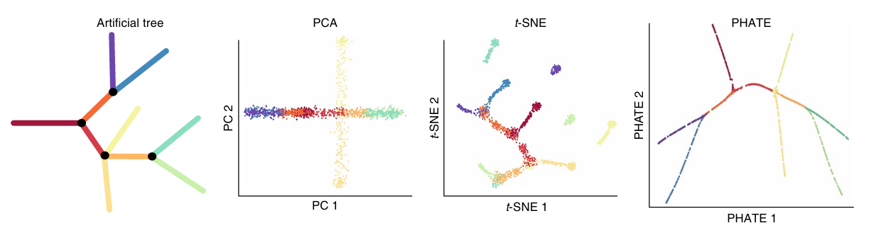
PHATE: Potential of heat diffusion for affinity-based transition embedding
Core idea:
1. Calculate similarity between local data points
Using alpha decay kernel
2. Calculate distances between data points globally:
Diffusion maps
3. Map potential distance information into low dimensions
Using MDS
Moon, van Dijk, Wang, et al. (2019)
Notes:
PCA ignores branches and shows the maximum variance and loses local structure, like light green and dark green branches overlap and are not distinguishable, whereas t-sne only focuses on forming similar luster but does not care about global structure but PHATE here preserves global as well as local structure, the trajectories formed describes the behavious of artificial tree

Slide 7
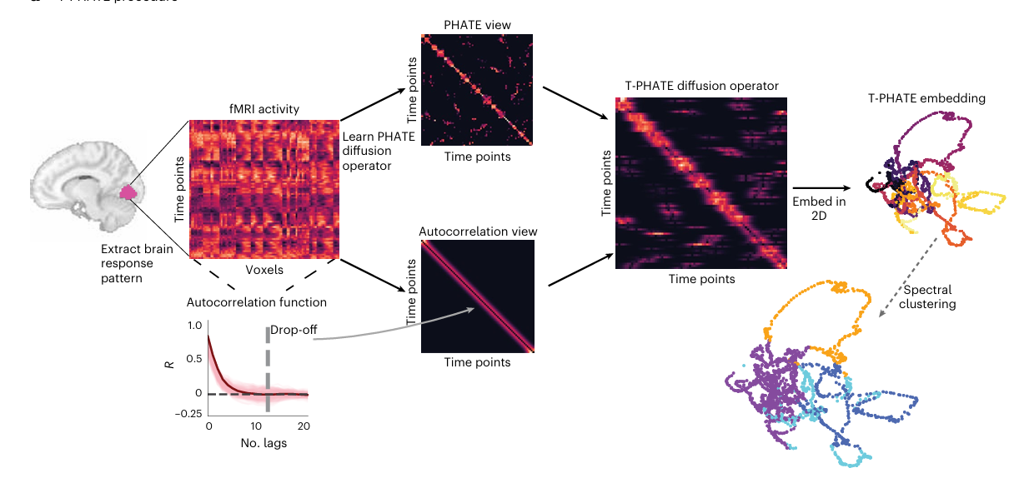
TPHATE: Temporal PHATE
Temporal PHATE to analyze the sequential order of data
Dual-Diffusion Operator: Geometric similarity (PHATE) + time autocorrelation
Busch et al., 2023)
Notes:
T-PHATE builds on PHATE but has a temporal view by data's autocorrelation structure i.e how a signal is related to its past timestamp
Calculates similarity between local time points: Explicitly takes the time index into its distance calculations and link nearby data points along the temporal sequence

Slide 8
Research Questions & Hypotheses
Does 'time-aware' learning (T-PHATE) outperform 'time-agnostic' learning (PCA/t-SNE/UMAP) for ERP-related EEG data?
Which metrics best evaluate temporal preservation in dimensionality reduction?
Hypotheses: T-PHATE will significantly outperform standard methods in:
Preserving the ground-truth structure of EEG/ERP data
Show the continuous ERP component trajectory from P100-N170-P300 even in multiple conditions
Notes:
"Traditional methods like PCA or t-SNE treat every data point as independent. But the brain is a dynamical system—what happens at time t is connected to time t-1.
Can we find a method that doen't just cluster the data, but actually shows the 'flow' of the brain's response?

Slide 9
Methods and Approach
Using Julia and Python
High-speed generation of EEG data using UnfoldSim.jl
Julia enables the simulation of complex multi-subject designs in seconds.
Customize noise at single-subject and multi-subject levels (essential for TPHATE and PHATE as they denoise the data as well)
Apply various dimensionality reduction techniques in Python, like
PCA
T-SNE
UMAP
PHATE
TPHATE
Notes:
Simulation of data using julia to know the ground truth of the data so that we know what is expected outcome and what can be analyzed from the data

Slide 10
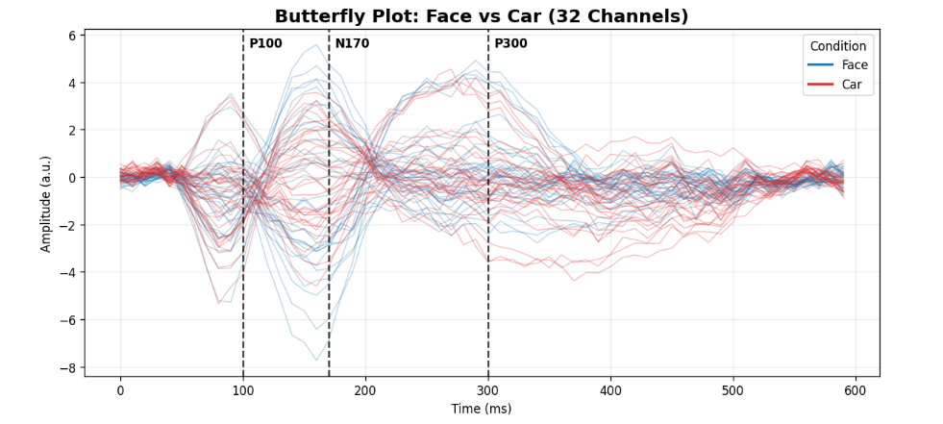
Data Simulation: Single-Subject Design
Notes:
Recognizing and processing face vs car during: N170

Slide 11
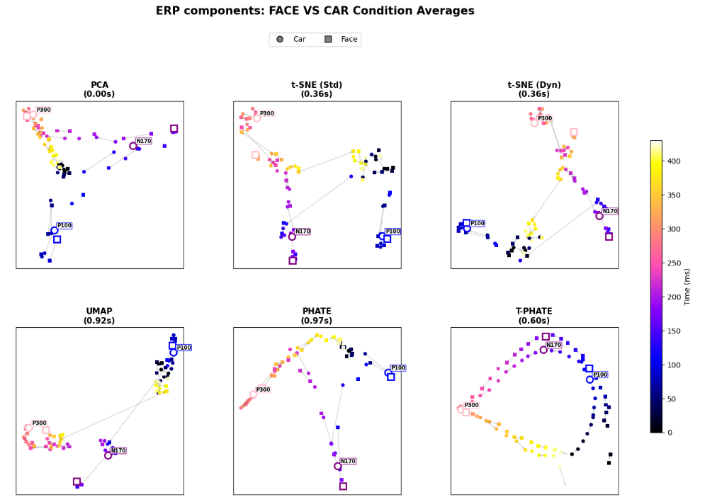
Dimensionality reduction methods on simulated data
Notes:
single subject average across trials per condition

Slide 12
Algorithms
 | PCA | t-SNE | UMAP | PHATE | T-PHATE
Geometry | Linear | Non-Linear | Non-Linear | Non-Linear | Non-Linear
Structure Preservation | Maximum variance, global structure | Local structure | Local & Global structure | Local & Global structure | Local & Global structure
Temporal Data Handling | No | No | No | Good for trajectories, but does not explicitly use time | Explicitly incorporates time.
Notes:
I am comparing five major methods. While PCA and UMAP are the standards, I am focusing on T-PHATE, which uses an autocorrelation-based affinity matrix to respect time

Slide 13
Timeline
Tasks | Thesis Duration (December 2025- June 2026)
 | December | January | February | March | April | May | June | July
Proposal
Literature Review
Intro presentation
Data Simulation
Implementation
Metric Evaluation
Mid term presentation
Analysis
Final presentation
Review

Slide 14
References
Campana-Olivo, R., & Manian, V. (2011). Parallel implementation of nonlinear dimensionality reduction methods applied in object segmentation using CUDA in GPU.
Moon, K. R., van Dijk, D., Wang, Z., et al. (2019). Visualizing structure and transitions in high-dimensional biological data. Nature Biotechnology, 37(12), 1482–1492. https://doi.org/10.1038/s41587-019-0336-3
Busch, E. L., Huang, J., Benz, A., et al. (2023). Multi-view manifold learning of human brain-state trajectories. Nature Computational Science, 3(3), 240–253. https://doi.org/10.1038/s43588-023-00419-0
Zhang, J., Yang, Y., Liu, T., Shi, Z., Pei, G., Wang, L., Wu, J., Funahashi, S., Suo, D., Wang, C., & Yan, T. (2023). Functional connectivity in people at clinical and familial high risk for schizophrenia. Psychiatry Research, 328, 115464.

